Slide 1

Green Pace
Security Policy Presentation
Developer: Caroline Wilson

Slide 2

OVERVIEW: DEFENSE IN DEPTH
The following will be a presentation of best practices and theories in secure coding standard. The information therein is paramount to success in writing secure, functional code with minimal vulnerabilities.

Slide 3
THREATS MATRIX
Likely FIO30-C, INT30-C, INT32-C, STR50-CPP | Priority ENV33-C, ERR51-CPP, MEM31-C, MSC41-C
Low priority STR30-C | Unlikely ERR53-CPP
The threat matrix breaks down and ranks the risk assessment based on priority level.

Slide 4
10 PRINCIPLES
Validate input data, Heed Compiler Warnings, Architect and Design for Security Policies, Keep it Simple, Default Deny, Adhere to the Principal of least Privilege, Sanitize Data Sent to Other Systems, Practice Defense in Depth, Use Quality Assurance Techniques, Adopt a Secure Coding Standard
These can apply to one or more coding standards throughout the secure coding process

Slide 5
CODING STANDARDS
These coding standards are ranked by risk and priority in the following table
Rule | Severity | Likelihood | Remediation Cost | Priority | Level
ENV33-C | High | Probable | Medium | P12 | L1
ERR51-CPP | Low | Probable | Medium | P4 | L3
ERR53-CPP | Low | Unlikely | Medium | P2 | L3
FIO30-C | High | Likely | Medium | P18 | L1
INT30-C | High | Likely | High | P9 | L2
INT32-C | High | Likely | High | P9 | L2
MEM31-C | Medium | Probable | Medium | P8 | L2
MSC41-C | High | Probable | Medium | P12 | L1
STR30-C | Low | Likely | Low | P9 | L2
STR50-CPP | High | Likely | Medium | P18 | L1

Slide 6
ENCRYPTION POLICIES
Encryption in Rest: Physical Media
Encryption at Flight: Transmission
Encryption in Use: ie Personal Passphrases

Slide 7
TRIPLE-A POLICIES
Authentication
Authorization
Accounting

Slide 8
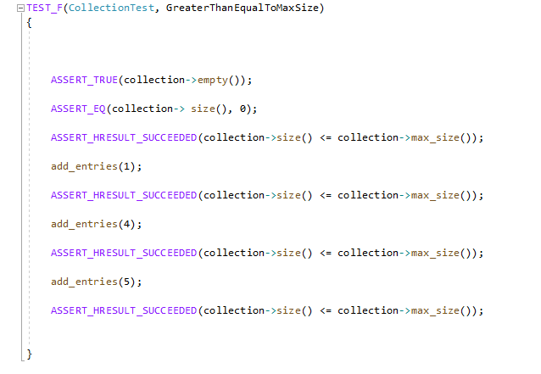
Unit Testing
Check for max size

Slide 9
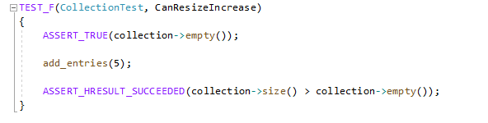
Unit Testing
Check to ensure size increase

Slide 10
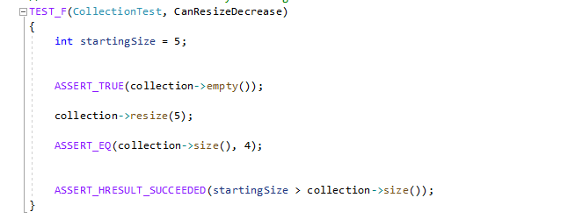
Unit Testing
Check for size decrease

Slide 11
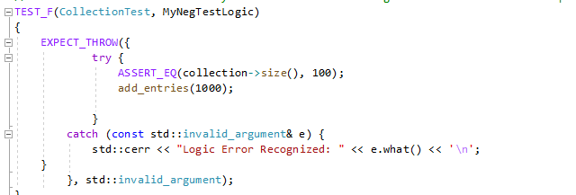
Unit Testing
Negative Test for Logic

Slide 12
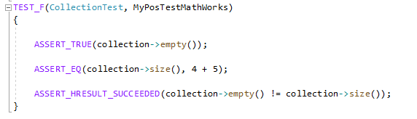
Unit Testing
Positive Test for Math Functionality

Slide 13

AUTOMATION SUMMARY

Slide 14
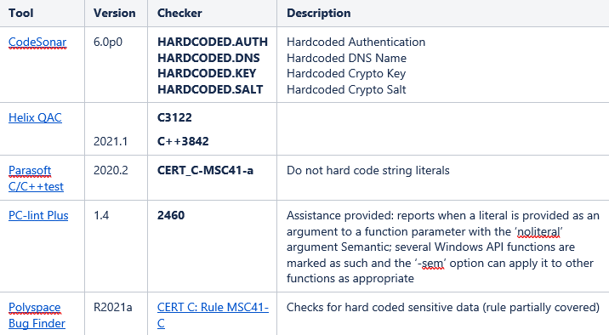
TOOLS
The DevSecOps pipeline is a practice that adds to the standard DevOps practice by addressing security early and often through the process.

Slide 15
RISKS AND BENEFITS
Prioritize and act now
Set expectations going forward
Have a plan in place to ensure the quality of previous work

Slide 16
RECOMMENDATIONS
Test early and often
Secure coding best practices
Follow Ten Core Security Principals
Training

Slide 17
CONCLUSIONS
Adhere to Principal of Least Privilege/Default Deny
Sanitize Data sent to other systems
Practice Defense in Depth
Use Effective Quality Assurance Techniques

Slide 18
REFERENCES
Confluence. (n.d.). Retrieved from https://wiki.sei.cmu.edu/confluence/pages/viewpage.action?pageId=88046682)

